Slide 1
Trade Mark Registration
“Protecting your brand”

Slide 2
Trade Mark
Trade Mark – (Brand) a sign that is graphically represented and identifies and distinguishes goods and services of one undertaken from those of another.

Slide 3
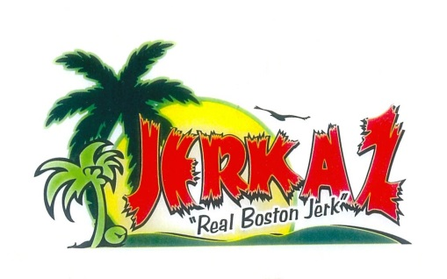
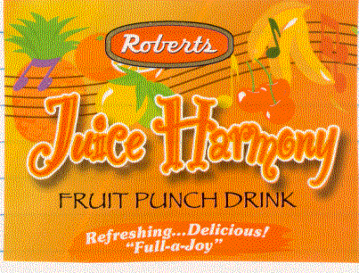
Trade Marks

Slide 4
TM in a global context
Choose names that appeals – be comfortable
Create unique names – be creative
Avoid generic names – TM refusal
Avoid descriptive, obscene names – TM refusal
Research names – internet search, registry search
Words may have different meanings globally

Slide 5
Trade Mark Registration
“Dance a yaad before yuh dance abroad”
Register in Jamaica first
Seek legal advise

Slide 6
The TM fee structure
(1) Application fee:
$7,800 (first class)
$2,200 (per additional class)
(2) Upon Acceptance fee:
$10,000.00
- Application form; list of goods and/or services; and copies of the Mark

Slide 7
Benefits of Registration
Trade Mark Registration
Ownership
License
Transfer of ownership
Legal action, i.e. Enforcement
Consumer confidence
Protection
Assist in overseas registration
Needed for Madrid Protocol
Relative grounds of refusal

Slide 8
Does TM registration in Jamaica provide worldwide coverage?
Protection is only in Jamaica
Applicants must seek registration in other countries, through:
Individual country Registration
Regional Registration
International Registration
Madrid Protocol

Slide 9
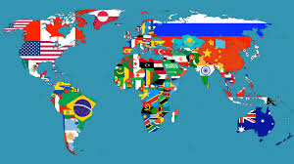
International Registration
Individual Countries
Apply directly (online where available)
Normally through a local agent
Foreign fees
Mark must meet requirements

Slide 10
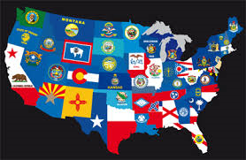
Registration in the US
Apply directly to the USPTO (online or paper)
No need for local agent to file*
Office filing fees
US has strict requirements:
Specimen of the Mark
Goods/services must be very specific
Proof of use in commerce is needed before mark is registered
Proof of use after registration, between 5th – 6th year and 9th – 10th year

Slide 11
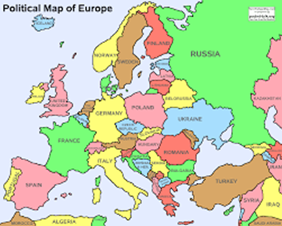
International Registration
Regional Registration Systems
CTM (Europe) 27 States
ARIPO (African Reg. Ind. Property Org.) 18 States
OAPI (African Intellectual Property Org.) 17 States
Apply directly Regional office
Need representative
Applicable fees
Must meet requirements for registration

Slide 12
How does the System Work
Jamaica
USA
MADRID System
UK
Japan
China

Slide 13
Madrid Protocol
International registration of Trade Marks
Avoid individual filing
Designate the countries for registration
Individual country fees & examination
Avoid agents in each countries
Easier to manage (Changes, renewals, etc.)
Dependent on basic application or registration
91 Member States*
International Application submitted to WIPO through Member State IP Office*

Slide 14
Thank You
Presented by
Herman Dawson
Telephone: (876).946.1300 / 946-0789
Fax: (876).927-6744
Website: http://www.jipo.gov.jm
Email: info@jipo.gov.jm

